Slide 1




Smart Lock System
Teams12:
Peining Liu(2615219L), Hao Zhang(3028132Z), Mengyang He (3030975H),
Hao Sun (2955851S), Chengyi Lyu(2960858L)
https://github.com/Peink/Team12-Real-Time-Embedded-Programming-2024-25
https://www.instagram.com/uogrtep.t12.2025/

Slide 2
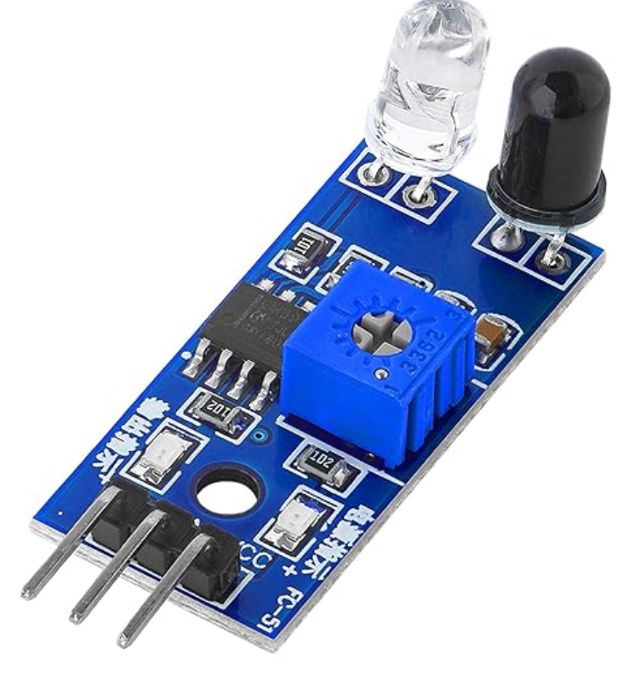
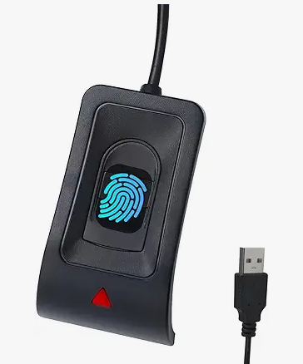
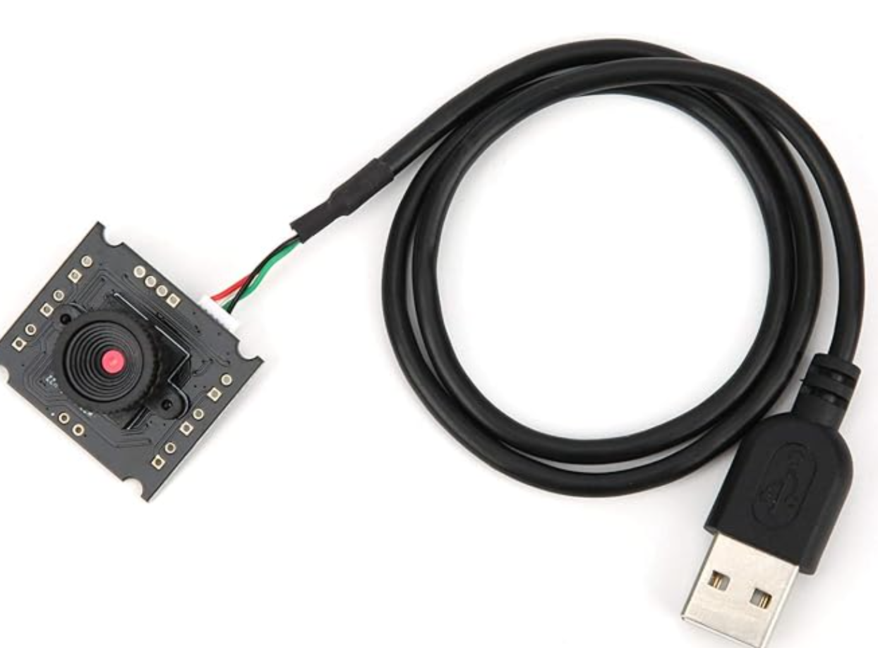
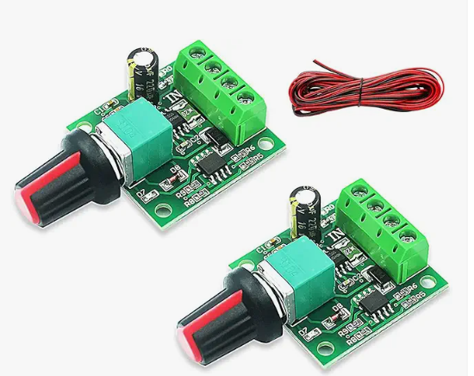
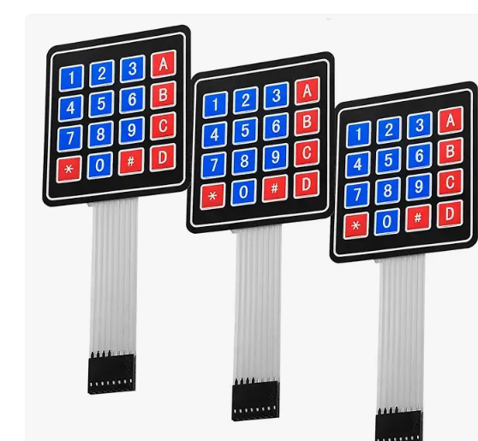
Smart Lock System
Facial Recognition System
Infrared distance Camera module
Finger Print Lock
Fingerprint sensor module
Remote Monitoring
Remote alarm(buzzer) Data collection Time recording
Password Lock
Matching key numbers (Matrix buttons)
Motor Control
Hardware 3D printed enclosure
SENSORS
HARDWARES
&
SOFTWARES
Notes:
System Architecture
Hardware Components
Raspberry Pi 5 (4G) – Main processing unit running C++ programs.
Infrared Distance Sensor – Detects objects in front of the lock.
Camera Module – Captures images for facial recognition.
Fingerprint Scanner – Ensures secure authentication.
Motor Control – Operates the locking mechanism.
Combination Lock – matching the key numbers.
Cooling System & 3D-Printed Enclosure – Enhances stability and durability.
Software Development (C++)
OpenCV – Facial recognition.
QT Framework – Web-based remote monitoring interface.
Embedded System Development – Controlling sensors, fingerprint recognition, and motor functions.
Data Communication – Enabling remote alerts and user management.
Expected Outcomes
Smart Unlocking – Fingerprint & facial recognition authentication.
Remote Monitoring – Web interface via QT framework.
Security Alert System – Infrared detection + remote alarm.
Hardware & Software Integration – C++-based control of all components.

Slide 3

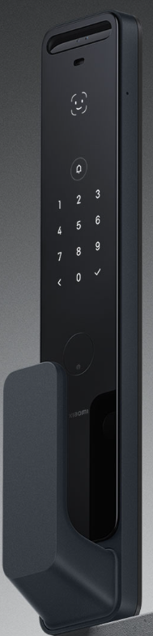
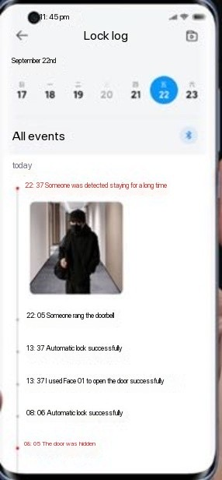
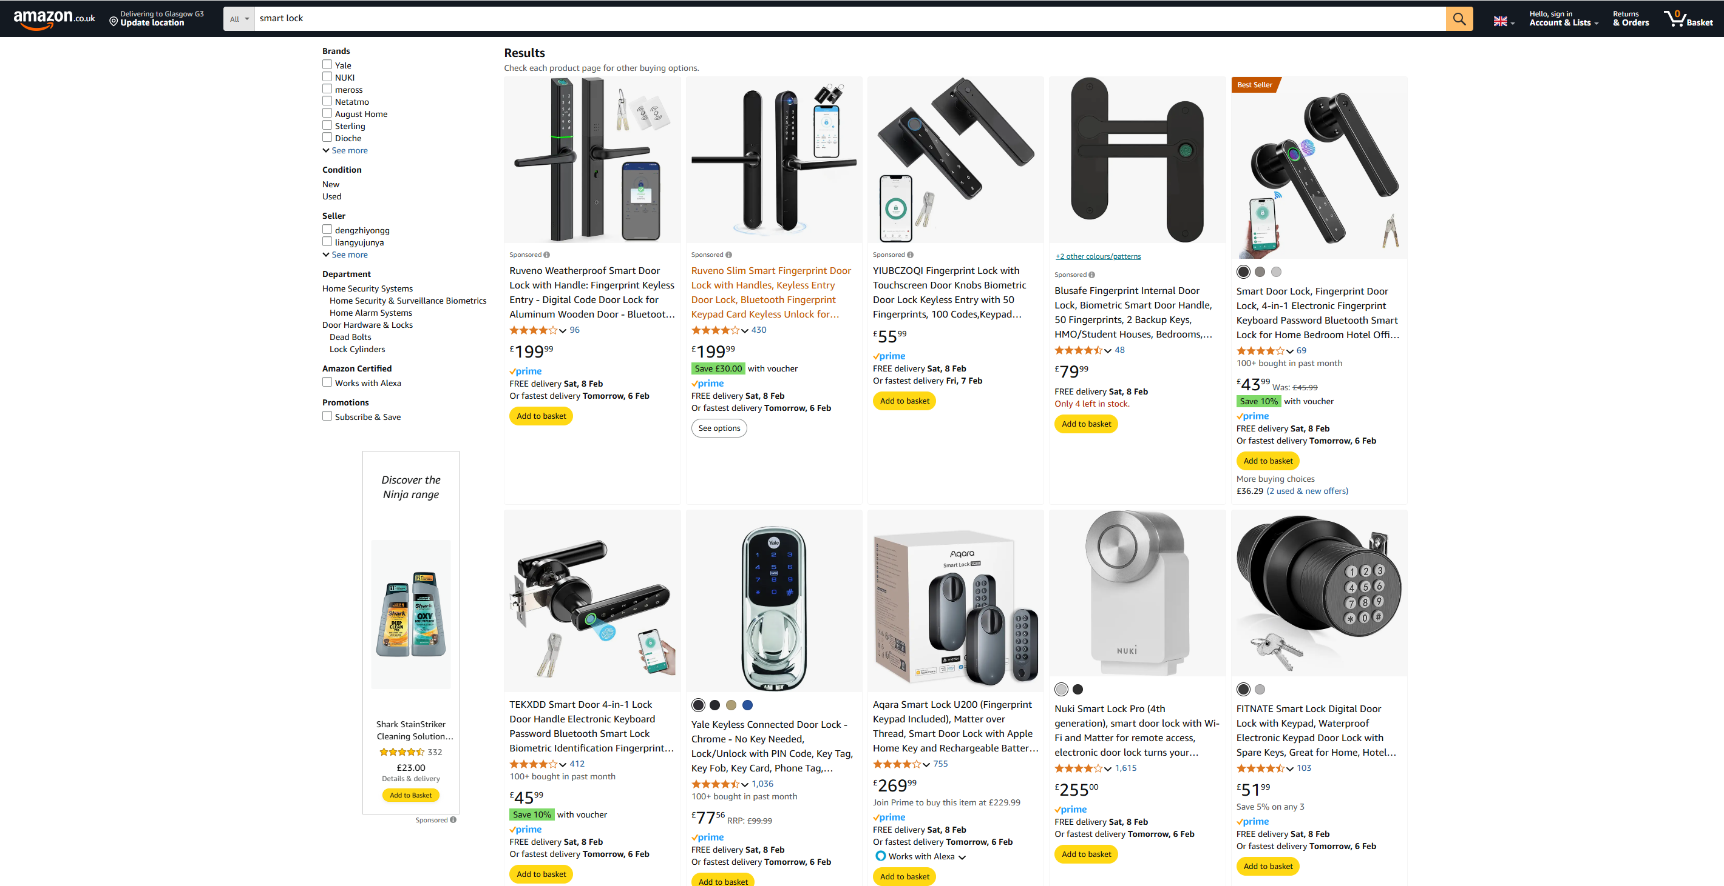
Practicality and Innovation
Practicality
Multi-factor authentication
Remote monitoring and alarm systems
Versatile for various applications
Data recording
Innovation
Combination with real-time
Remote detection recording
Notes:
Smart Lock System Development
Practicality
Traditional locks are vulnerable (keys can be lost, passwords can be leaked).
Smart locks provide multi-factor authentication for enhanced security.
Remote monitoring and alarm systems improve user experience.
2. Research Objectives
Develop an efficient and stable C++-based smart lock system.
Integrate facial recognition, fingerprint authentication, and infrared detection.
Enable remote monitoring and security alerts via a web interface.
Utilize Raspberry Pi 5 (4G) as the embedded development platform.

Slide 4

Thank You

